Slide 1
Searching: Deterministic single-agent
Andrew W. Moore Professor
School of Computer Science Carnegie Mellon University
www.cs.cmu.edu/~awm awm@cs.cmu.edu
412-268-7599
Slide 1
Note to other teachers and users of these slides. Andrew would be delighted if you found this source material useful in giving your own lectures. Feel free to use these slides verbatim, or to modify them to fit your own needs. PowerPoint originals are available. If you make use of a significant portion of these slides in your own lecture, please include this message, or the following link to the source repository of Andrew’s tutorials: http://www.cs.cmu.edu/~awm/tutorials . Comments and corrections gratefully received.
Overview
Deterministic, single-agent, search problems
Breadth First Search
Optimality, Completeness, Time and Space complexity
Search Trees
Depth First Search
Iterative Deepening
Best First “Greedy” Search
Slide 2

Slide 2
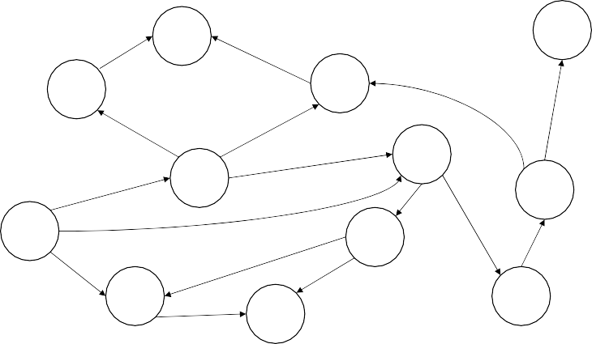
A search problem
a
GOAL
b
c
d
e
f
START
h
p r
q
How do we get from S to G? And what’s the smallest possible number of transitions?
Slide 3
Formalizing a search problem
A search problem has five components:
Q , S , G , succs , cost
Q is a finite set of states.
S ⊆ Q is a non-empty set of start states.
G ⊆ Q is a non-empty set of goal states.
succs : Q € P(Q) is a function which takes a state as input and returns a set of states as output. succs(s) means “the set of states you can reach from s in one step”.
cost : Q , Q € Positive Number is a function which takes two states, s and s’, as input. It returns the one-step cost of traveling from s to s’. The cost function is only defined when s’ is a successor state of s.
Slide 4

Slide 3

Our Search Problem
b
a
c
GOAL
d
e
f
START
h
p r
q
Q = {START, a , b , c , d , e , f , h , p , q , r , GOAL} S = { START }
G = { GOAL }
succs(b) = { a }
succs(e) = { h , r }
succs(a) = NULL … etc.
cost(s,s’) = 1 for all transitions
Slide 5
Our Search Problem
b
a
c
GOAL
d
e
f
START
h
p r
q
Q = {START, a , b , c , d , e , f , h , p , q , r , GOAL} S = { START }
G = { GOAL }
succs(b) = { a }
succs(e) = { h , r }
succs(a) = NULL … etc.
cost(s,s’) = 1 for all transitions
Why do we care? What
problems are like this?
Slide 6

Slide 4

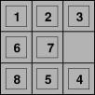
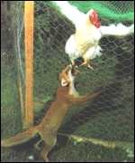


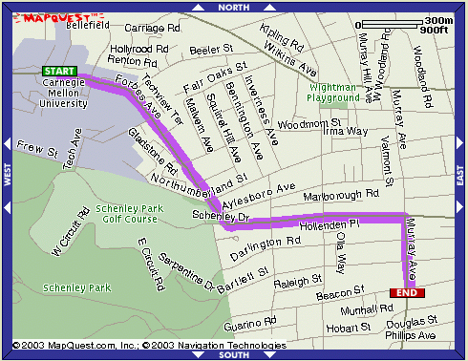



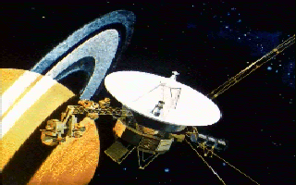
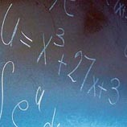


Search Problems
Slide 7
More Search Problems
8-Queens
What next?
Slide 8
Scheduling

Slide 5


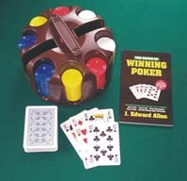


More Search Problems
But there are plenty of things which we’d
Sche
duling
normally call search problems that don’t fit our
rigid definition…
A search problem has five components:
Q , S , G , succs , cost
Q is a finite set of states.
S ⊆ Q is a non-empty set of start states.
G ⊆ Q is a non-empty set of goal states.
succs : Q € P(Q) is a function which takes a state as input and returns a set of states as output. succs(s) means “the set of states you can reach from s in one step”.
cost : Q , Q € Positive Number is a function which takes two states, s and s’, as input. It returns the one-step cost of traveling from s to s’. The cost function is only defined when s’ is a successor state of s.
8-Queens
What next?
Can you think of examples?
Slide 9
Our definition excludes…
Slide 10

Slide 6
Our definition excludes…
Game against adversary
Chance
Hidden State
Continuum (infinite number) of states
All of the above, plus distributed team control
Slide 11
Breadth First Search
b
a
c
GOAL
d
e
f
START
h
p r
q
Label all states that are reachable from S in 1 step but aren’t reachable in less than 1 step.
Then label all states that are reachable from S in 2 steps but aren’t reachable in less than 2 steps.
Then label all states that are reachable from S in 3 steps but aren’t reachable in less than 3 steps.
Etc… until Goal state reached.
Slide 12

Slide 7
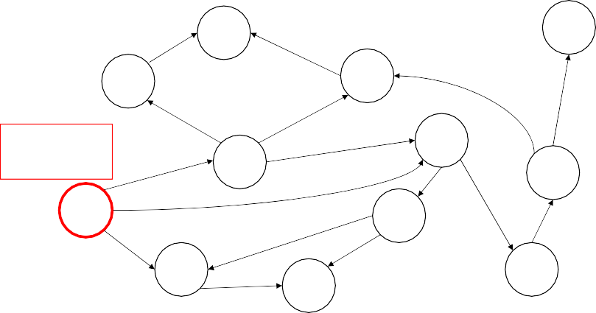
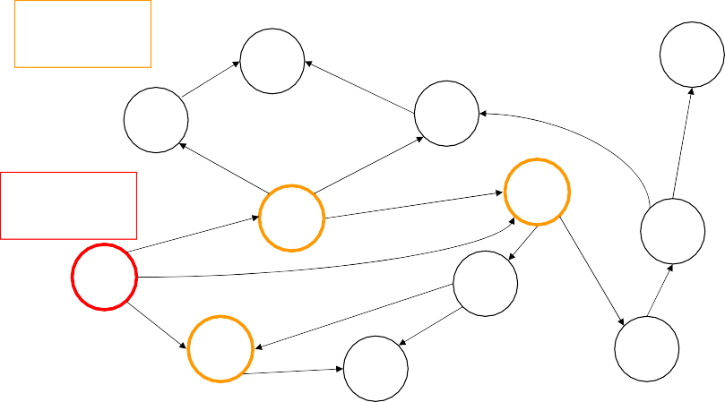
Breadth-first Search
a
GOAL
b
c
0 steps from start
d
e
f
START
h
p
q
r
Slide 13
Breadth-first Search
a
1 step from start
GOAL
b
c
0 steps from start
d
e
f
START
h
p
q
r
Slide 14

Slide 8
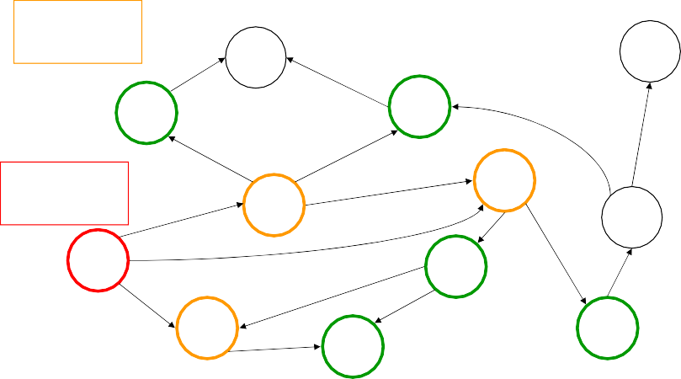
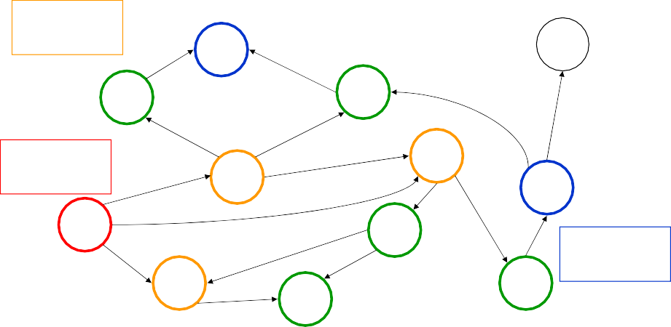
Breadth-first Search
1 step from start
GOAL
a
b
c
0 steps from start
d
e
f
START
h
p
q
r
2 steps from start
Slide 15
Breadth-first Search
a
1 step from start
GOAL
b
c
0 steps from start
d
e
f
START
h
3 steps from start
p
q
r
2 steps from start
Slide 16

Slide 9
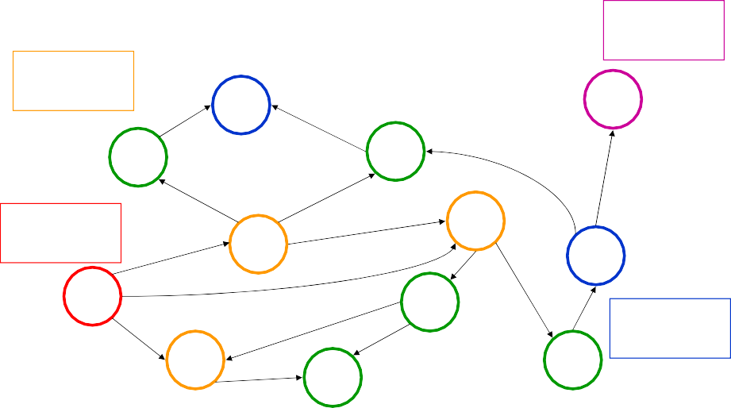
Breadth-first Search
4 steps from start
GOAL
1 step from start
a
b
c
0 steps from start
d
e
f
START
h
3 steps from start
p
q
r
2 steps from start
Slide 17
Remember the path!
b
a
c
GOAL
d
e
f
START
h
p r
q
Also, when you label a state, record the predecessor state. This record is called a backpointer. The history of predecessors is used to generate the solution path, once you’ve found the goal:
“I’ve got to the goal. I see I was at f before this. And I was at r before I was at f. And I was…
…. so solution path is S € e € r € f € G”
Slide 18

Slide 10
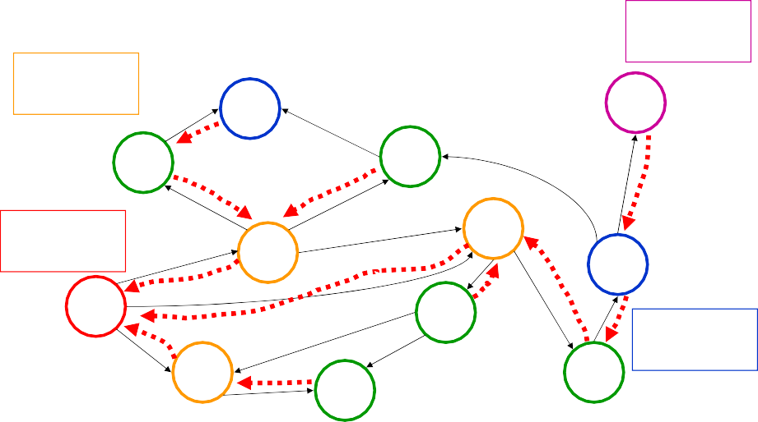
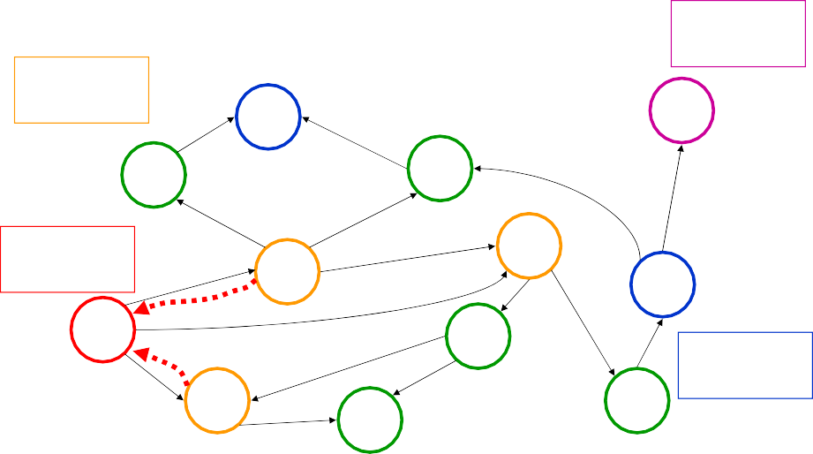

Backpointers
4 steps from start
GOAL
1 step from start
a
b
c
0 steps from start
d
e
f
START
h
3 steps from start
p
q
r
2 steps from start
Slide 19
Backpointers
a
4 steps from start
GOAL
1 step from start
b
c
0 steps from start
d
e
f
START
h
3 steps from start
p
q
r
2 steps from start
Slide 20

Slide 11
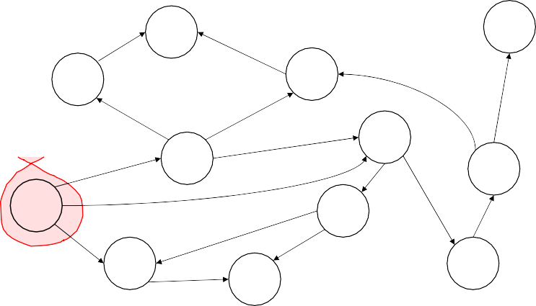
Starting Breadth First Search
For any state s that we’ve labeled, we’ll remember:
previous(s) as the previous state on a shortest path from START state to s.
On the kth iteration of the algorithm we’ll begin with V_{k} defined as the set of those states for which the shortest path from the start costs exactly k steps
Then, during that iteration, we’ll compute V_{k+1}, defined as the set of those states for which the shortest path from the start costs exactly k+1 steps
We begin with k = 0, V₀ = {START} and we’ll define, previous(START)
= NULL
Then we’ll add in things one step from the START into V₁. And we’ll keep going.
Slide 21
BFS
a
GOAL
b
c
d
e
f
START
h
V₀
p
q
r
Slide 22

Slide 12
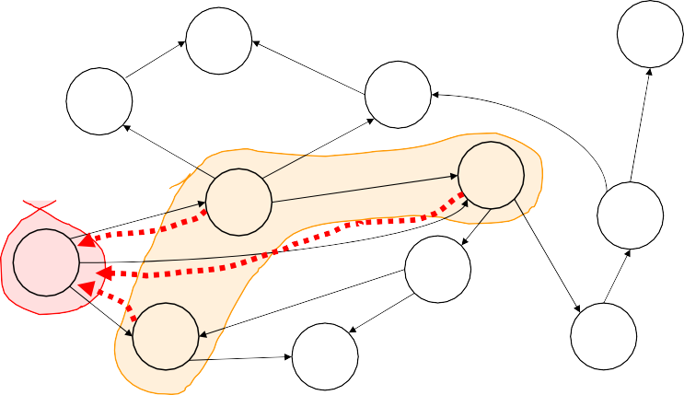
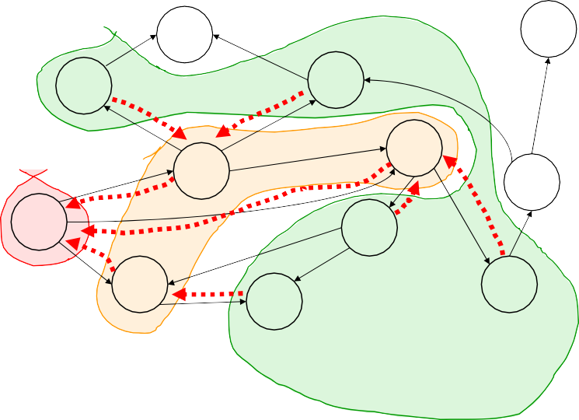
BFS
a
GOAL
b
c
d
e
f
START
h
V₀
p
q
r
V₁
Slide 23
BFS
a
GOAL
b
c
d
e
f
START
h
V₀
p
q
r
V₁
V₂
Slide 24

Slide 13
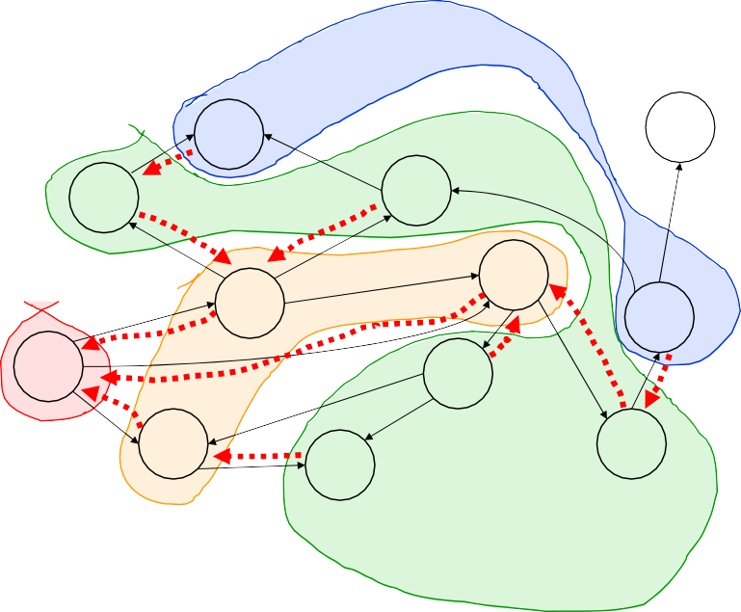
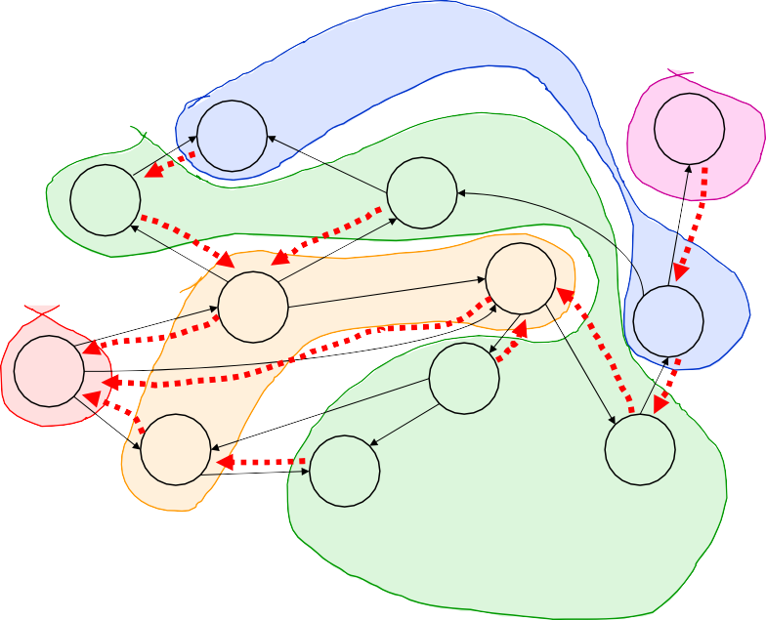
BFS
a
GOAL
b
c
d
e
V
f
3
START
h
V₀
p
q
r
V₁
V₂
Slide 25
BFS
V₄
a
GOAL
b
c
d
e
V
f
3
START
h
V₀
p
q
r
V₁
V₂
Slide 26

Slide 14
Breadth First Search
V₀ := S (the set of start states)
previous(START) := NIL k := 0
while (no goal state is in V_{k} and V_{k} is not empty) do
V_{k+1} := empty set For each state s in V_{k}
For each state s’ in succs(s)
If s’ has not already been labeled Set previous(s’) := s
Add s’ into V_{k+1}
k := k+1
If V_{k} is empty signal FAILURE
Else build the solution path thus: Let S_{i} be the ith state in the shortest path. Define S_{k} = GOAL, and forall i <= k, define S_{i-1} = previous(S_{i}).
Slide 27
BFS
V₄
a
GOAL
b
c
d
e
V
Suppose your search space conveniently
f
3
START
allowed you to obtain predecessors(state).
h
V₀
Can you think of a different way to do BFS?
p
q
r
And would you be able to avoid storing
something that we’d previously had to
V₁
V₂
store?
Slide 28

Slide 15
Another way: Work back
b
a
c
GOAL
d
e
f
START
h
p r
q
Label all states that can reach G in 1 step but can’t reach it in less than 1 step.
Label all states that can reach G in 2 steps but can’t reach it in less than 2 steps.
Etc. … until start is reached.
“number of steps to goal” labels determine the shortest path. Don’t need extra bookkeeping info.
Slide 29
Breadth First Details
It is fine for there to be more than one goal state.
It is fine for there to be more than one start state.
This algorithm works forwards from the start. Any algorithm which works forwards from the start is said to be forward chaining.
You can also work backwards from the goal. This algorithm is very similar to Dijkstra’s algorithm.
Any algorithm which works backwards from the goal is said to be backward chaining.
Backward versus forward. Which is better?
Slide 30

Slide 16
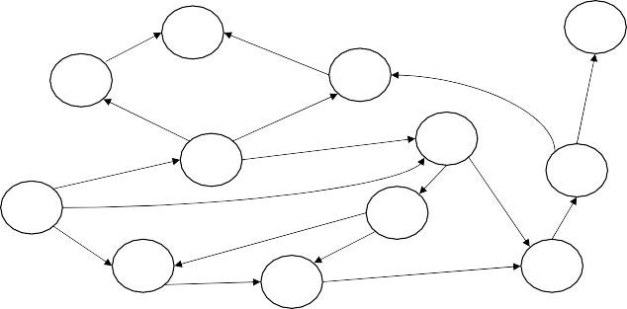
Costs on transitions
2
a
2
GOAL
b
1
8
c
5
5
3
d
2
e
f
START
9
h
1
9
1
p
4
4
3
r
5
1
5
q
Notice that BFS finds the shortest path in terms of number of transitions. It does not find the least-cost path.
We will quickly review an algorithm which does find the least-cost path. On the kth iteration, for any state S, write g(s) as the least-cost path to S in k or fewer steps.
Slide 31
Least Cost Breadth First
V_{k} = the set of states which can be reached in exactly k steps, and for which the least- cost k-step path is less cost than any path of length less than k. In other words, V_{k} = the set of states whose values changed on the previous iteration.
V₀ := S (the set of start states) previous(START) := NIL g(START) = 0
k := 0
while (V_{k} is not empty) do
V_{k+1} := empty set For each state s in V_{k}
For each state s’ in succs(s)
If s’ has not already been labeled OR if g(s) + Cost(s,s’) < g(s’)
Set previous(s’) := s
Set g(s’) := g(s) + Cost(s,s’)
Add s’ into V_{k+1}
k := k+1
If GOAL not labeled, exit signaling FAILURE
Else build the solution path thus: Let S_{k} be the kth state in the shortest path. Define S_{k} = GOAL, and forall i <= k, define S_{i-1} = previous(S_{i}).
Slide 32

Slide 17

Uniform-Cost Search
A conceptually simple BFS approach when there are costs on transitions
It uses priority queues
Slide 33
Priority Queue Refresher
A priority queue is a data structure in which you can insert and retrieve (thing, value) pairs with the following operations:
Init-PriQueue(PQ) | initializes the PQ to be empty.
Insert-PriQueue(PQ, thing, value) | inserts (thing, value) into the queue.
Pop-least(PQ) | returns the (thing, value) pair with the lowest value, and removes it from the queue.
Slide 34

Slide 18
Priority Queue Refresher
A priority queue is a data structure in which you can insert and retrieve (thing, value) pairs with the following operations:
For more details, see Knuth
or Sedgwick or basically
any book with the word
“algorithms” prominently
appearing in the title.
Init-PriQueue(PQ) | initializes the PQ to be empty.
Insert-PriQueue(PQ, thing, value) | inserts (thing, value) into the queue.
Pop-least(PQ) | returns the (thing, value) pair with the lowest value, and removes it from the queue.
Priority Queues can be implemented in such a way that the cost of the insert and pop operations are
Very cheap (though not absolutely, incredibly cheap!)
O(log(number of things in priority queue))
Slide 35
Uniform-Cost Search
A conceptually simple BFS approach when there are costs on transitions
It uses a priority queue
PQ = Set of states that have been expanded or are awaiting expansion
Priority of state s = g(s) = cost of getting to s using path implied by backpointers.
Slide 36

Slide 19
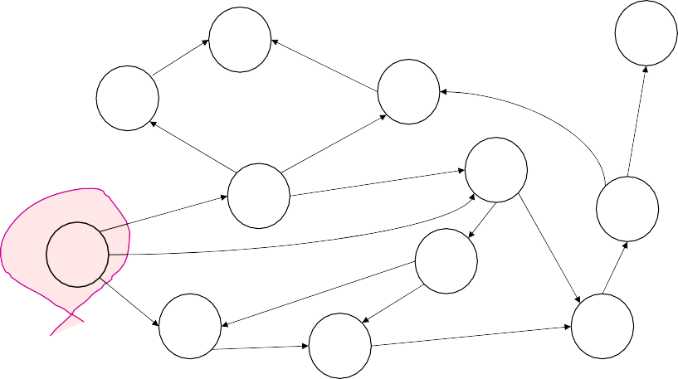

Starting UCS
2
a
2
GOAL
b
c
2
5
1
8
2
3
d
e
9
1
9
f
START
1
4
h
5
p
15
q
4
3
r
PQ = { (S,0) }
Slide 37
UCS Iterations
2
a
2
GOAL
b
c
2
5
1
8
2
3
d
e
9
1
9
f
START
1
4
h
5
p
15
q
4 3
r
Iteration:
Pop least-cost state from PQ
Add successors
Slide 38
PQ = { (S,0) }

Slide 20
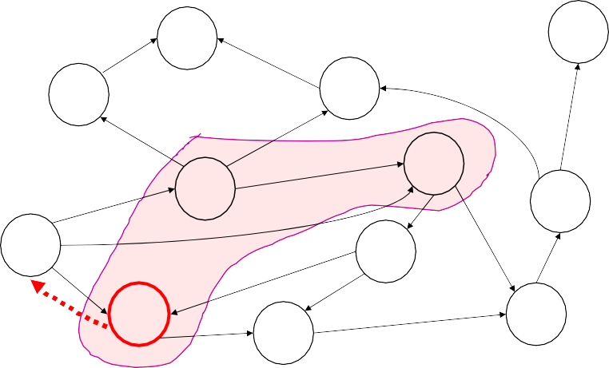
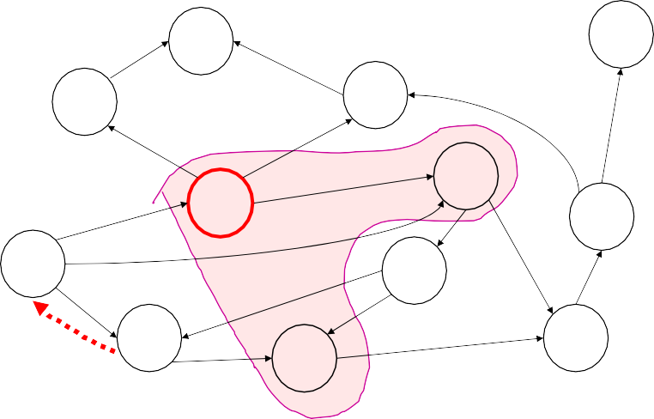
UCS Iterations
2
a
2
GOAL
b
c
2
5
1
8
2
3
d
e
9
1
9
f
START
1
4
h
5
p
15
q
4 3
r
Iteration:
1. Pop least-cost state from PQ
PQ = { (p,1), (d,3) , (e,9) } 2. Add successors
Slide 39
UCS Iterations
2
a
2
GOAL
b
c
2
5
1
8
2
3
d
e
9
1
9
f
START
1
4
h
5
p
15
q
4
3
r
Iteration:
Pop least-cost state from PQ
Add successors
Slide 40
PQ = { (d,3) , (e,9) , (q,16) }

Slide 21
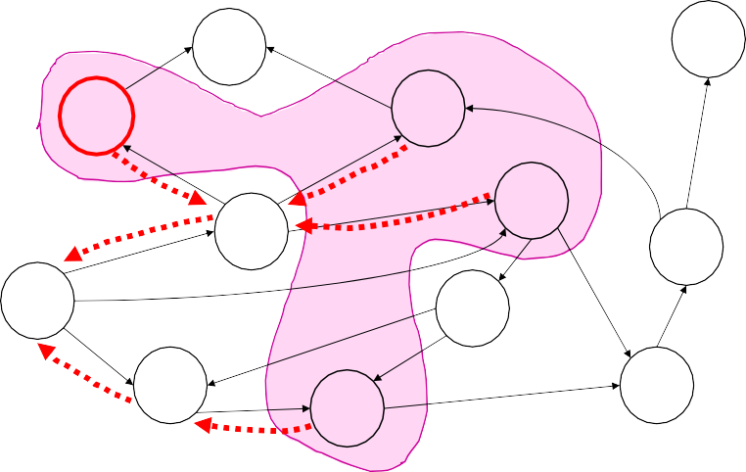

UCS Iterations
2
a
2
GOAL
b
c
2
5
1
8
2
3
d
e
9
1
9
f
START
1
4
h
5
p
15
q
4
3
r
Iteration:
Pop least-cost state from PQ
Add successors
Slide 41
PQ = { (b,4) , (e,5) , (c,11) , (q,16) }
UCS Iterations
2
a
2
GOAL
b
c
2
5
1
8
2
3
d
e
9
1
9
f
START
4
h
5
1
Note what happened here:
d realized that getting to e via d was
p
15
4
3
r
better than the previously best-known
q
Iteration:
Pop least-cost state from PQ
Add successors
Slide 42
way to get to e
and so e’s priority was changed
PQ = { (b,4) , (e,5) , (c,11) , (q,16) }

Slide 22
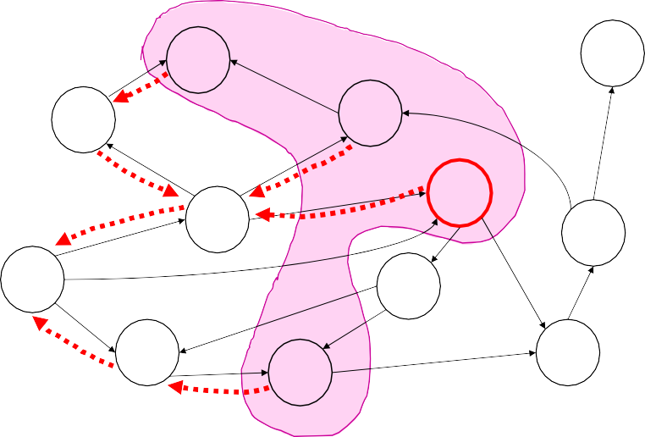
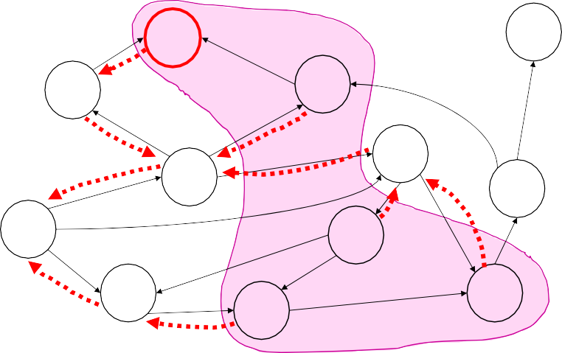
UCS Iterations
2
a
2
GOAL
b
c
2
5
1
8
2
3
d
e
9
1
9
f
START
1
4
h
5
p
15
q
4
3
r
Iteration:
Pop least-cost state from PQ
Add successors
Slide 43
PQ = { (e,5) , (a,6) , (c,11) , (q,16) }
UCS Iterations
2
a
2
GOAL
b
c
2
5
1
8
2
3
d
e
9
1
9
f
START
1
4
h
5
p
15
q
4 3
r
Iteration:
1. Pop least-cost state from PQ
PQ = { (a,6),(h,6),(c,11),(r,14),(q,16) } 2. Add successors
Slide 44

Slide 23
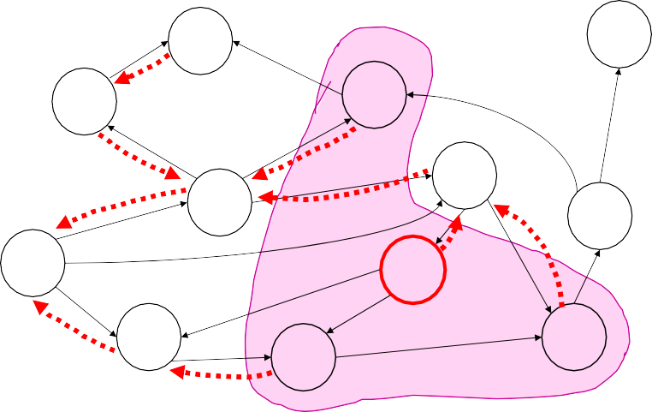
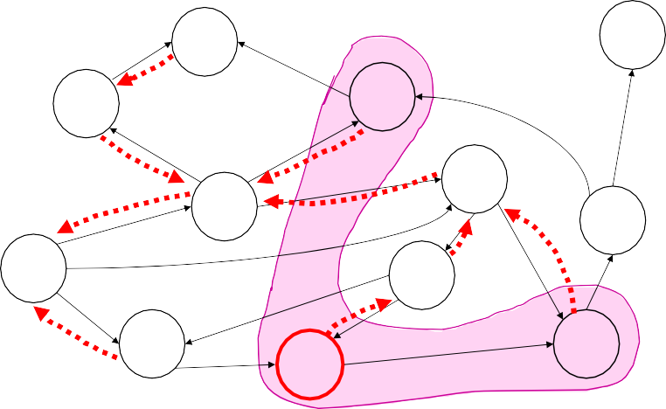
UCS Iterations
2
a
2
GOAL
b
c
2
5
1
8
2
3
d
e
9
1
9
f
START
1
4
h
5
p
15
q
4
3
r
Iteration:
Pop least-cost state from PQ
Add successors
Slide 45
PQ = { (h,6),(c,11),(r,14),(q,16) }
UCS Iterations
2
a
2
GOAL
b
c
2
5
1
8
2
3
d
e
9
1
9
f
START
1
4
h
5
p
15
q
4
3
r
Iteration:
Pop least-cost state from PQ
Add successors
Slide 46
PQ = { (q,10), (c,11),(r,14) }

Slide 24

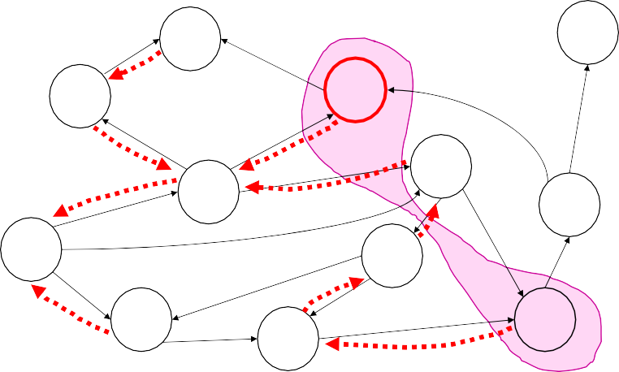
UCS Iterations
Note what happened here:
h found a new way to get to p
GOAL
2
a
2
•
but it was more costly than the best kno^{wn way}
b
c
2
•
and so p’s priority was unchanged
5
1
8
2
3
d
e
9
1
9
f
START
1
4
h
5
p
15
q
4
3
r
Iteration:
Pop least-cost state from PQ
Add successors
Slide 47
PQ = { (q,10), (c,11),(r,14) }
UCS Iterations
2
a
2
GOAL
b
c
2
5
1
8
2
3
d
e
9
1
9
f
START
1
4
h
5
p
15
q
4
3
r
Iteration:
Pop least-cost state from PQ
Add successors
Slide 48
PQ = { (c,11),(r,13) }

Slide 25
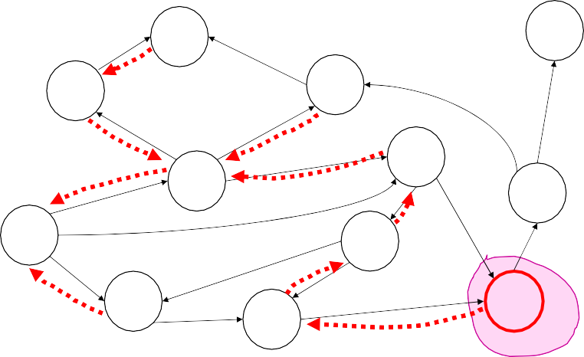
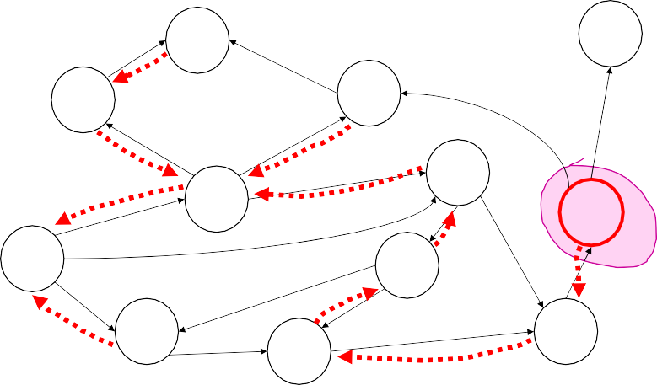
UCS Iterations
2
a
2
GOAL
b
c
2
5
1
8
2
3
d
e
9
1
9
f
START
1
4
h
5
p
15
q
4
3
r
Iteration:
Pop least-cost state from PQ
Add successors
Slide 49
PQ = { (r,13) }
UCS Iterations
2
a
2
GOAL
b
c
2
5
1
8
2
3
d
e
9
1
9
f
START
1
4
h
5
p
15
q
4
3
r
Iteration:
Pop least-cost state from PQ
Add successors
Slide 50
PQ = { (f,18) }

Slide 26
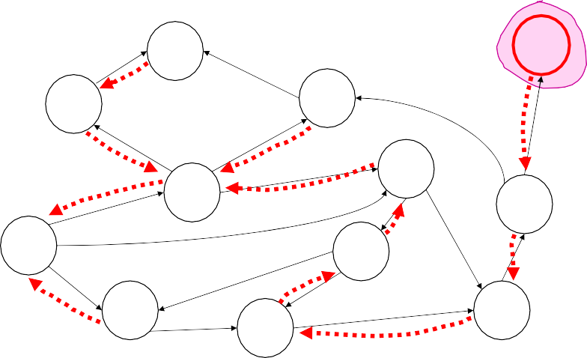

UCS Iterations
2
a
2
GOAL
b
c
2
5
1
8
2
3
d
e
9
1
9
f
START
1
4
h
5
p
15
q
4
3
r
Iteration:
Pop least-cost state from PQ
Add successors
Slide 51
PQ = { (G,23) }
UCS Iterations
Question: Is “terminate as soon as you ^{discover}
the goal” the right stopping criterion?
GOAL
2
a
2
b
c
2
5
1
8
2
3
d
e
9
1
9
f
START
1
4
h
5
p
15
q
4
3
r
Iteration:
Pop least-cost state from PQ
Add successors
Slide 52
PQ = { (G,23) }

Slide 27
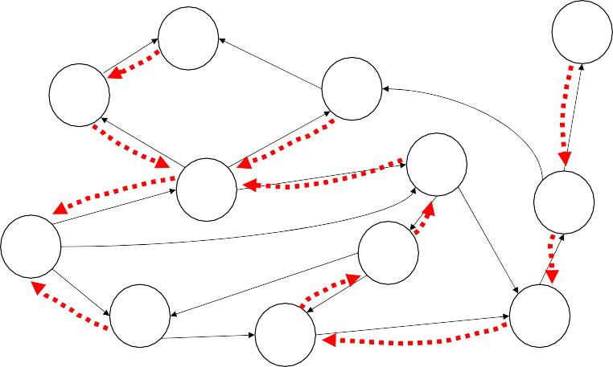
UCS terminates
2
a
2
GOAL
b
c
2
5
1
8
Terminate only once the goal is popped from the
2
e
priority queue. Else we may ^{miss a shorter path.}
3
d
9
1
9
f
START
1
4
h
5
p
15
q
4
3
r
Iteration:
Pop least-cost state from PQ
Add successors
Slide 53
PQ = { }
Judging a search algorithm
Completeness: is the algorithm guaranteed to find a solution if a solution exists?
Guaranteed to find optimal? (will it find the least cost path?)
Algorithmic time complexity
Space complexity (memory use)
Variables:
N | number of states in the problem
B | the average branching factor (the average number of successors) (B>1)
L | the length of the path from start to goal with the shortest number of steps
How would we judge our algorithms?
Slide 54

Slide 28
Judging a search algorithm
N | number of states in the problem
B | the average branching factor (the average number of successors) (B>1)
L | the length of the path from start to goal with the shortest number of steps
Q | the average size of the priority queue
Algorithm |  | Comp lete | Optimal | Time | Space
BFS | Breadth First Search
LCBFS | Least Cost BFS
UCS | Uniform Cost Search
Slide 55
Judging a search algorithm
N | number of states in the problem
B | the average branching factor (the average number of successors) (B>1)
L | the length of the path from start to goal with the shortest number of steps
Q | the average size of the priority queue
Algorithm |  | Comp lete | Optimal | Time | Space
BFS | Breadth First Search | Y | if all transitions same cost | O(min(N,B^{L})) | O(min(N,B^{L}))
LCBFS | Least Cost BFS | Y | Y | O(min(N,B^{L})) | O(min(N,B^{L}))
UCS | Uniform Cost Search | Y | Y | O(log(Q) * min(N,B^{L})) | O(min(N,B^{L}))
Slide 56

Slide 29
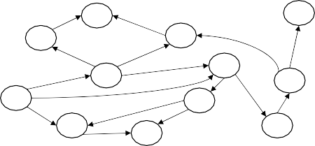
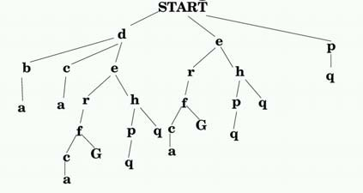
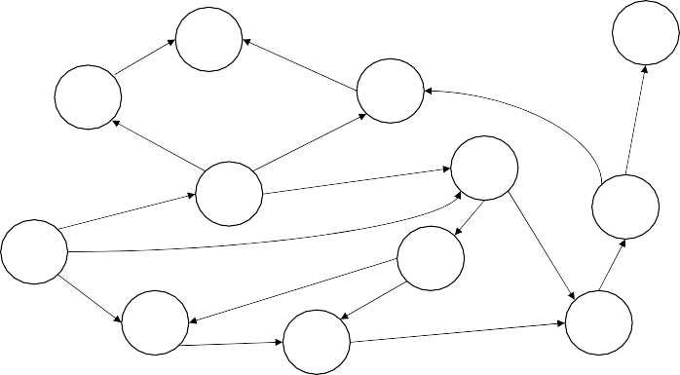
Search Tree Representation
a
GOAL
b c
_{d} e
START
h
f
p
q
r
What order do we go through
the search tree with BFS?
Slide 57
Depth First Search
2
a
2
GOAL
b
c
5
5
1
8
2
e
3
d
9
1
9
f
START
1
4
h
5
p
15
q
4
3
r
An alternative to BFS. Always expand from the most- recently-expanded node, if it has any untried successors. Else backup to the previous node on the current path.
Slide 58

Slide 30

DFS in action
b
a
c
GOAL
START START d START d b
START d b a
START d c
START d c a
START d e
START d e r START d e r f START d e r f c START d e r f c a
d
e
f
START
h
p
q
r
START d e r f GOAL
Slide 59
DFS Search tree traversal
a
GOAL
b c
_{d} e
Can you draw in the order in which the search-tree nodes are visited?
START
h
f
p
q
r
Slide 60

Slide 31

DFS Algorithm
We use a data structure we’ll call a Path to represent the , er, path from the START to the current state.
E.G. Path P = <START, d, e, r >
Along with each node on the path, we must remember which successors we still have available to expand. E.G. at the following point, we’ll have
P = <START (expand=e , p) , d (expand = NULL) ,
e (expand = h) , r (expand = f) >
Slide 61
DFS Algorithm
Let P = <START (expand = succs(START))> While (P not empty and top(P) not a goal)
if expand of top(P) is empty then
remove top(P) (“pop the stack”)
else
let s be a member of expand of top(P) remove s from expand of top(P)
make a new item on the top of path P: s (expand = succs(s))
If P is empty
return FAILURE
Else
return the path consisting of states in P
This algorithm can be written neatly with recursion, i.e. using the program stack to implement P.
Slide 62

Slide 32
Judging a search algorithm
N | number of states in the problem
B | the average branching factor (the average number of successors) (B>1)
L | the length of the path from start to goal with the shortest number of steps
Q | the average size of the priority queue
Algorithm |  | Comp lete | Optimal | Time | Space
BFS | Breadth First Search | Y | if all transitions same cost | O(min(N,B^{L})) | O(min(N,B^{L}))
LCBFS | Least Cost BFS | Y | Y | O(min(N,B^{L})) | O(min(N,B^{L}))
UCS | Uniform Cost Search | Y | Y | O(log(Q) * min(N,B^{L})) | O(min(N,B^{L}))
DFS | Depth First Search
Slide 63
Judging a search algorithm
N | number of states in the problem
B | the average branching factor (the average number of successors) (B>1)
L | the length of the path from start to goal with the shortest number of steps
Q | the average size of the priority queue
Algorithm |  | Comp lete | Optimal | Time | Space
BFS | Breadth First Search | Y | if all transitions same cost | O(min(N,B^{L})) | O(min(N,B^{L}))
LCBFS | Least Cost BFS | Y | Y | O(min(N,B^{L})) | O(min(N,B^{L}))
UCS | Uniform Cost Search | Y | Y | O(log(Q) * min(N,B^{L})) | O(min(N,B^{L}))
DFS | Depth First Search | N | N | N/A | N/A
Slide 64

Slide 33
Judging a search algorithm
N | number of states in the problem
B | the average branching factor (the average number of successors) (B>1)
L | the length of the path from start to goal with the shortest number of steps
Q | the average size of the priority queue
Algorithm |  | Comp lete | Optimal | Time | Space
BFS | Breadth First Search | Y | if all transitions same cost | O(min(N,B^{L})) | O(min(N,B^{L}))
LCBFS | Least Cost BFS | Y | Y | O(min(N,B^{L})) | O(min(N,B^{L}))
UCS | Uniform Cost Search | Y | Y | O(log(Q) * min(N,B^{L})) | O(min(N,B^{L}))
DFS** | Depth First Search
Assuming Acyclic Search Space
Slide 65
Judging a search algorithm
N | number of states in the problem
B | the average branching factor (the average number of successors) (B>1)
L | the length of the path from start to goal with the shortest number of steps
LMAX | Length of longest path from start to anywhere
Q | the average size of the priority queue
Algorithm |  | Comp lete | Optimal | Time | Space
BFS | Breadth First Search | Y | if all transitions same cost | O(min(N,B^{L})) | O(min(N,B^{L}))
LCBFS | Least Cost BFS | Y | Y | O(min(N,B^{L})) | O(min(N,B^{L}))
UCS | Uniform Cost Search | Y | Y | O(log(Q) * min(N,B^{L})) | O(min(N,B^{L}))
DFS** | Depth First Search | Y | N | _{O(B}LMAX₎ | O(LMAX)
Assuming Acyclic Search Space
Slide 66

Slide 34
Questions to ponder
How would you prevent DFS from looping?
How could you force it to give an optimal solution?
Slide 67
Questions to ponder
How would you prevent DFS from looping?
Answer 1:
PC-DFS (Path Checking DFS):
Answer 2:
MEMDFS (Memoizing DFS):
How could you force it to give an optimal solution?
Slide 68

Slide 35
Questions to ponder
How would you prevent DFS from looping?
Answer 1:
PC-DFS (Path Checking DFS):
Don’t recurse on a state if that state is already in the current path
Answer 2:
MEMDFS (Memoizing DFS):
Remember all states expanded so far. Never expand anything twice.
How could you force it to give an optimal solution?
Slide 69
Questions to ponder
How would you prevent DFS from looping?
Answer 1:
PC-DFS (Path Checking DFS):
Don’t recurse on a state if that state is already in the current path
Are there occasions when PCDFS is
better than MEMDFS?
Answer 2:
MEMDFS (Memoizing DFS):
Remember all states expanded so far. Never expand anything twice.
How could you force it to give an optimal solution?
Are there occasions when MEMDFS
is better than PCDFS?
Slide 70

Slide 36
Judging a search algorithm
N | number of states in the problem
B | the average branching factor (the average number of successors) (B>1)
L | the length of the path from start to goal with the shortest number of steps
LMAX | Length of longest cycle-free path from start to anywhere
Q | the average size of the priority queue
Algorithm |  | Comp lete | Optimal | Time | Space
BFS | Breadth First Search | Y | if all transitions same cost | O(min(N,B^{L})) | O(min(N,B^{L}))
LCBFS | Least Cost BFS | Y | Y | O(min(N,B^{L})) | O(min(N,B^{L}))
UCS | Uniform Cost Search | Y | Y | O(log(Q) * min(N,B^{L})) | O(min(N,B^{L}))
PCDFS | Path Check DFS
MEMDFS | Memoizing DFS
Slide 71
Judging a search algorithm
N | number of states in the problem
B | the average branching factor (the average number of successors) (B>1)
L | the length of the path from start to goal with the shortest number of steps
LMAX | Length of longest cycle-free path from start to anywhere
Q | the average size of the priority queue
Algorithm |  | Comp lete | Optimal | Time | Space
BFS | Breadth First Search | Y | if all transitions same cost | O(min(N,B^{L})) | O(min(N,B^{L}))
LCBFS | Least Cost BFS | Y | Y | O(min(N,B^{L})) | O(min(N,B^{L}))
UCS | Uniform Cost Search | Y | Y | O(log(Q) * min(N,B^{L})) | O(min(N,B^{L}))
PCDFS | Path Check DFS | Y | N | _{O(B}LMAX₎ | O(LMAX)
MEMDFS | Memoizing DFS | Y | N | O(min(N,B^{LMAX})) | O(min(N,B^{LMAX}))
Slide 72

Slide 37

Judging a search algorithm
N | number of states in the problem
B | the average branching factor (the average number of successors) (B>1)
L | the length of the path from start to goal with the shortest number of steps
LMAX | Length of longest cycle-free path from start to anywhere
Q | the average size of the priority queue
Algorithm |  | Comp lete | Optimal | Time | Space
BFS | Breadth First Search | Y | if all transitions same cost | O(min(N,B^{L})) | O(min(N,B^{L}))
LCBFS | Least Cost BFS | Y | Y | O(min(N,B^{L})) | O(min(N,B^{L}))
UCS | Uniform Cost Search | Y | Y | O(log(Q) * min(N,B^{L})) | O(min(N,B^{L}))
PCDFS | Path Check DFS | Y | N | _{O(B}LMAX₎ | O(LMAX)
MEMDFS | Memoizing DFS | Y | N | O(min(N,B^{LMAX})) | O(min(N,B^{LMAX}))
Slide 73
Maze example
Imagine states are cells in a maze, you can move N, E, S, W. What would plain DFS do, assuming it always expanded the E successor first, then N, then W, then S?
G
Expansion order E, N, W, S
S
Other questions:
What would BFS do? What would PCDFS do?
What would MEMDFS do? Slide 74

Slide 38


Two other DFS examples
G
Order: N, E, S, W?
S
G
Order: N, E, S, W with loops prevented
S
Slide 75
Forward DFSearch or Backward DFSearch
If you have a predecessors() function as well as a successors() function you can begin at the goal and depth-first-search backwards until you hit a start.
Why/When might this be a good idea?
Slide 76

Slide 39
Invent An Algorithm Time!
Here’s a way to dramatically decrease costs sometimes. Bidirectional Search. Can you guess what this algorithm is, and why it can be a huge cost-saver?
Slide 77
N | number of states in the problem
B | the average branching factor (the average number of successors) (B>1)
L | the length of the path from start to goal with the shortest number of steps
LMAX | Length of longest cycle-free path from start to anywhere
Q | the average size of the priority queue
Algorithm |  | Comp lete | Optimal | Time | Space
BFS | Breadth First Search | Y | if all transitions same cost | O(min(N,B^{L})) | O(min(N,B^{L}))
LCBFS | Least Cost BFS | Y | Y | O(min(N,B^{L})) | O(min(N,B^{L}))
UCS | Uniform Cost Search | Y | Y | O(log(Q) * min(N,B^{L})) | O(min(N,B^{L}))
PCDFS | Path Check DFS | Y | N | _{O(B}LMAX₎ | O(LMAX)
MEMDFS | Memoizing DFS | Y | N | O(min(N,B^{LMAX})) | O(min(N,B^{LMAX}))
BIBFS | Bidirection BF Search
Slide 78

Slide 40
N | number of states in the problem
B | the average branching factor (the average number of successors) (B>1)
L | the length of the path from start to goal with the shortest number of steps
LMAX | Length of longest cycle-free path from start to anywhere
Q | the average size of the priority queue
Algorithm |  | Comp lete | Optimal | Time | Space
BFS | Breadth First Search | Y | if all transitions same cost | O(min(N,B^{L})) | O(min(N,B^{L}))
LCBFS | Least Cost BFS | Y | Y | O(min(N,B^{L})) | O(min(N,B^{L}))
UCS | Uniform Cost Search | Y | Y | O(log(Q) * min(N,B^{L})) | O(min(N,B^{L}))
PCDFS | Path Check DFS | Y | N | _{O(B}LMAX₎ | O(LMAX)
MEMDFS | Memoizing DFS | Y | N | O(min(N,B^{LMAX})) | O(min(N,B^{LMAX}))
BIBFS | Bidirection BF Search | Y | All trans same cost | O(min(N,2B^{L/2})) | O(min(N,2B^{L/2}))
Slide 79
Iterative Deepening
Iterative deepening is a simple algorithm which uses DFS as a subroutine:
Do a DFS which only searches for paths of length 1 or less. (DFS gives up any path of length 2)
If “1” failed, do a DFS which only searches paths of length 2 or less.
If “2” failed, do a DFS which only searches paths of length 3 or less.
….and so on until success
Cost is
O(b¹ + b² + b³ + b⁴ … + b^{L}) = O(b^{L})
Can be much better than regular
But cost can be much
greater than the number of states.
DFS.
Slide 80

Slide 41

Maze example
Imagine states are cells in a maze, you can move N, E, S, W. What would Iterative Deepening do, assuming it always expanded the E successor first, then N, then W, then S?
G
S
Expansion order E, N, W, S
Slide 81
N | number of states in the problem
B | the average branching factor (the average number of successors) (B>1)
L | the length of the path from start to goal with the shortest number of steps
LMAX | Length of longest cycle-free path from start to anywhere
Q | the average size of the priority queue
Algorithm |  | Comp lete | Optimal | Time | Space
BFS | Breadth First Search | Y | if all transitions same cost | O(min(N,B^{L})) | O(min(N,B^{L}))
LCBFS | Least Cost BFS | Y | Y | O(min(N,B^{L})) | O(min(N,B^{L}))
UCS | Uniform Cost Search | Y | Y | O(log(Q) * min(N,B^{L})) | O(min(N,B^{L}))
PCDFS | Path Check DFS | Y | N | _{O(B}LMAX₎ | O(LMAX)
MEMDFS | Memoizing DFS | Y | N | O(min(N,B^{LMAX})) | O(min(N,B^{LMAX}))
BIBFS | Bidirection BF Search | Y | All trans same cost | O(min(N,2B^{L/2})) | O(min(N,2B^{L/2}))
ID | Iterative Deepening |  |  |  | Slide 82

Slide 42
N | number of states in the problem
B | the average branching factor (the average number of successors) (B>1)
L | the length of the path from start to goal with the shortest number of steps
LMAX | Length of longest cycle-free path from start to anywhere
Q | the average size of the priority queue
Algorithm |  | Comp lete | Optimal | Time | Space
BFS | Breadth First Search | Y | if all transitions same cost | O(min(N,B^{L})) | O(min(N,B^{L}))
LCBFS | Least Cost BFS | Y | Y | O(min(N,B^{L})) | O(min(N,B^{L}))
UCS | Uniform Cost Search | Y | Y | O(log(Q) * min(N,B^{L})) | O(min(N,B^{L}))
PCDFS | Path Check DFS | Y | N | _{O(B}LMAX₎ | O(LMAX)
MEMDFS | Memoizing DFS | Y | N | O(min(N,B^{LMAX})) | O(min(N,B^{LMAX}))
BIBFS | Bidirection BF Search | Y | All trans same cost | O(min(N,2B^{L/2})) | O(min(N,2B^{L/2}))
ID | Iterative Deepening | Y | if all transitions same cost | O(B^{L}) | O(L) Slide 83
Best First “Greedy” Search
Needs a heuristic. A heuristic function maps a state onto an estimate of the cost to the goal from that state.
Can you think of examples of heuristics?
E.G. for the 8-puzzle?
E.G. for planning a path through a maze?
Denote the heuristic by a function h(s) from states to a cost value.
Slide 84

Slide 43

Heuristic Search
Suppose in addition to the standard search specification we also have a heuristic.
A heuristic function maps a state onto an estimate of the cost to the goal from that state.
Can you think of examples of heuristics?
E.G. for the 8-puzzle?
E.G. for planning a path through a maze?
Denote the heuristic by a function h(s) from states to a cost value.
Slide 85
Euclidian Heuristic
2
a
2
GOAL
h=0
b
h=8
c
2
h=11
1
8
h=5
h=4
e
5
3
d
2
h=8
9
1
9
f
h=4
START
1
4
h
h=6
5
h=12
p
15
4
3
r
h=11
q
h=6
h=9
Slide 86

Slide 44
Euclidian Heuristic
2
a
2
GOAL
h=0
b
h=8
c
2
1
8
h=5 h=4
e
5
h=11
Another priority queue algorithm.
2
•
But this time, priority is the heuristic
3
h=8
d
9
1
9
f
START
•
value.
h
h=4
h=12
1
4
h=6
5
p
15
q
4
3
r
h=11
h=9
h=6
Slide 87
Best First “Greedy” Search
Init-PriQueue(PQ)
Insert-PriQueue(PQ,START,h(START))
while (PQ is not empty and PQ does not contain a goal state) (s , h ) := Pop-least(PQ)
foreach s’ in succs(s)
if s’ is not already in PQ and s’ never previously been visited Insert-PriQueue(PQ,s’,h(s’))
Algorithm |  | Comp lete | Optimal | Time | Space
BestFS | Best First Search | Y | N | O(min(N,B^{LMAX})) | O(min(N,B^{LMAX}))
A few improvements to this algorithm can make things much better. It’s a little thing we like to call: A*….
…to be continued!
Slide 88

Slide 45
What you should know
Thorough understanding of BFS, LCBFS, UCS. PCDFS, MEMDFS
Understand the concepts of whether a search is complete, optimal, its time and space complexity
Understand the ideas behind iterative deepening and bidirectional search
Be able to discuss at cocktail parties the pros and cons of the above searches
Slide 89

